Slide 1


DATA ANALYSIS
PORTFOLIO
DIVYASRI JEGAN

Slide 2
Portfolio
Professional Background
I am Divyasri Jegan currently pursuing my bachelor degree in the field AI & DS with a CGPA of 9.05. I am a highly motivated and results-oriented individual with a strong passion for data science and machine learning. I am proficient in Python, SQL, Tableau, and Machine Learning. I am also familiar with other data science tools and techniques.
I am excited to start my career in data science and use my skills to make a positive impact on the world. I am always eager to take on new challenges and I am confident that I can make a significant contribution to any team.
As a fresher, I am looking forward to experiencing the real challenges of the corporate world and understanding how things work. I am grateful for the opportunity to learn and I believe that by putting significant efforts, I will be able to learn and grow.
I’m always had dealt with practical learning rather than theoretical that makes an high impact in my learning.

Slide 3
Table of Contents
1. Data Analytics in Everyday life ------------------------------------------------------ 5-9
Found the best online certification program using data analytics and explaining it with
six steps data analytics process i.e. plan, prepare, process, analyze, share and act
2. Instagram User Analytics ------------------------------------------------------- 10-15
• Find business insights that can be used by teams across the business to launch a new marketing campaign, decide
on features to build for the app
• measuring user engagement and improving the experience altogether while helping the business grow
3. Operation & Metric Analytics ------------------------------------------------------- 16-23
• Used Advanced SQL skills to analyze the data to answer questions posed by different departments within
the company
• Provided valuable insights that can help in improving the company's operations and understand sudden
Changes in the metrics.
4. Hiring Process Analytics ------------------------------------------------------- 24-30
• Analyzed previous hiring dataset of an MNC to observe trends and drawing insights out of it useful for hiring
department
• Helped the company to improve its hiring process and make better hiring decisions in the future.

Slide 4
5. IMDB Movie Analysis ------------------------------------------------------ 31-38
• Generated meaningful insights from the IMDB dataset to plan every move analytically based on data
• Helped the company to make movie that appeals to both Indian and global audience while minimizing the risk of losses
6. Bank Loan Case Study ------------------------------------------------------- 38-45
• Used EDA to understand how customer attributes & loan attributes influence the likelihood of default
• This information helped the bank to make decisions such as denying the loan, reducing loan amount etc.
7. Impact of Car Features ------------------------------------------------------- 46-54
• Gained insights and provided recommendations for price optimization & product development decisions to maximize profitability
• Used regression analysis to identify the variables that have the strongest relationship with a car's price
• Created an Interactive Dashboard
8. ABC Call Trend Analysis ------------------------------------------------------- 55-61
• Analyzed inbound calling team data of a company, to extract useful insights
• provided recommendations for manpower planning to reduce call abandon rate from 30% to 10% and improve
customer experience.

Slide 5

Data Analysis in everyday life
Objective :
Explore the role of data analytics in choosing a self-productivity book and leveraging data-driven insights for personal development.
Data Analytics in Selecting the Best
Self-Productivity Book

Slide 6
Data Analysis in everyday life
Plan
Our plan is to select a best self-productivity book for personal development and mental strength. As there is a lot of books available in market (development, lifestyle, living, etc..)
We select it by the methodology as follows:
Objectives :
Improving time management, goal setting, and personal growth through the chosen book.
Key Criteria :
User ratings, content relevance, and practicality as evaluation parameters.
Data Sources :
Online bookstores, review platforms, and personal recommendations provide valuable
insights.
Learn More

Slide 7
Data Analysis in everyday life
Prepare
Data Gathering :
Collecting relevant information from diverse sources for comprehensive analysis.
We collect data about what are the books and what is makes.
Data Cleansing :
Removing duplicates and irrelevant information to ensure the integrity of the dataset.
We may also get the insight about the same book or about the resources ,so it is important in finding
the perfect data.
Process
Average Ratings :
If I find books in online platform , I could find the ratings of book that also involves rate, value add to it.
Book Summaries :
Compiled Summaries : Summarize the content and key takeaways of each book for comparison.
Ask about people suggestions, get insights from book readers, find valuable authors works.

Slide 8
Data Analysis in everyday life
Analyze
Interpret the findings, rank the books based on criteria, and identify common themes among the top-rated books for precise decision-making.
Ranking Criteria :
Rank books based on average user ratings, number of reviews, and alignment with personal goals.
Identify theme :
Analyze common themes and topics across the top-rated books for insightful selection.

Slide 9
Data Analysis in everyday life
Result :
Enhanced decision making:
Data-driven selection enhances decision-making abilities for personal progress.
Continuous Learning :
Encourage continuous exploration in both data analytics and personal development for holistic
growth.
From the above result we were able to identify the self help book bring productivity and I have found the Alchemist, Deep work and Atomic habits result in provides a better improvement for my growth.

Slide 10

2. Instagram User Analytics
Project Description :
This project will assist Instagram data analysts in analyzing user engagement
through SQL and MySQL Workbench.
This analysis of user interactions helps to identify loyal users, inactive accounts and trending hashtags among others.
Such findings are indispensable for the marketing team in order to run successful campaigns, the product team in their feature development prioritization and the development team on how to make the user's experience better.
The resulting analysis acts as a compass for Instagram future direction in strategic decision making concerning its business.

Slide 11
Instagram User Analytics
Approach :
Data Extraction and Filtering :
● Extract user engagement data like photo likes from the database using SQL queries.
● Filter to see users who have liked every single photo on the platform, which is an
indication of a bot.
Abnormal Engagement Detection :
● Analyze user engagement patterns in filtered dataset through developing SQL queries.
● Look for abnormal behavior such as consistently liking every photo, which is unlikely for
genuine users, indicating potential bot or fake account activity.
Reporting and Further Investigation :
● Share with stakeholders the list of people with suspicious likings.
● Propose further investigations into these accounts to confirm whether they are indeed bots or
fake accounts. Additional data analysis or manual review processes might be required.

Slide 12
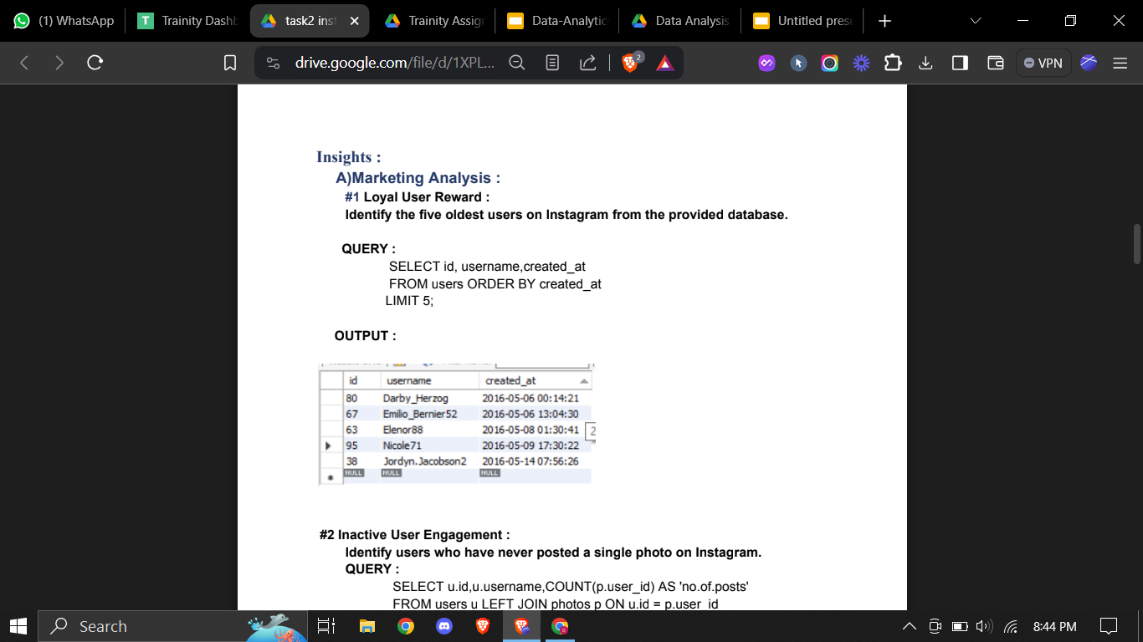
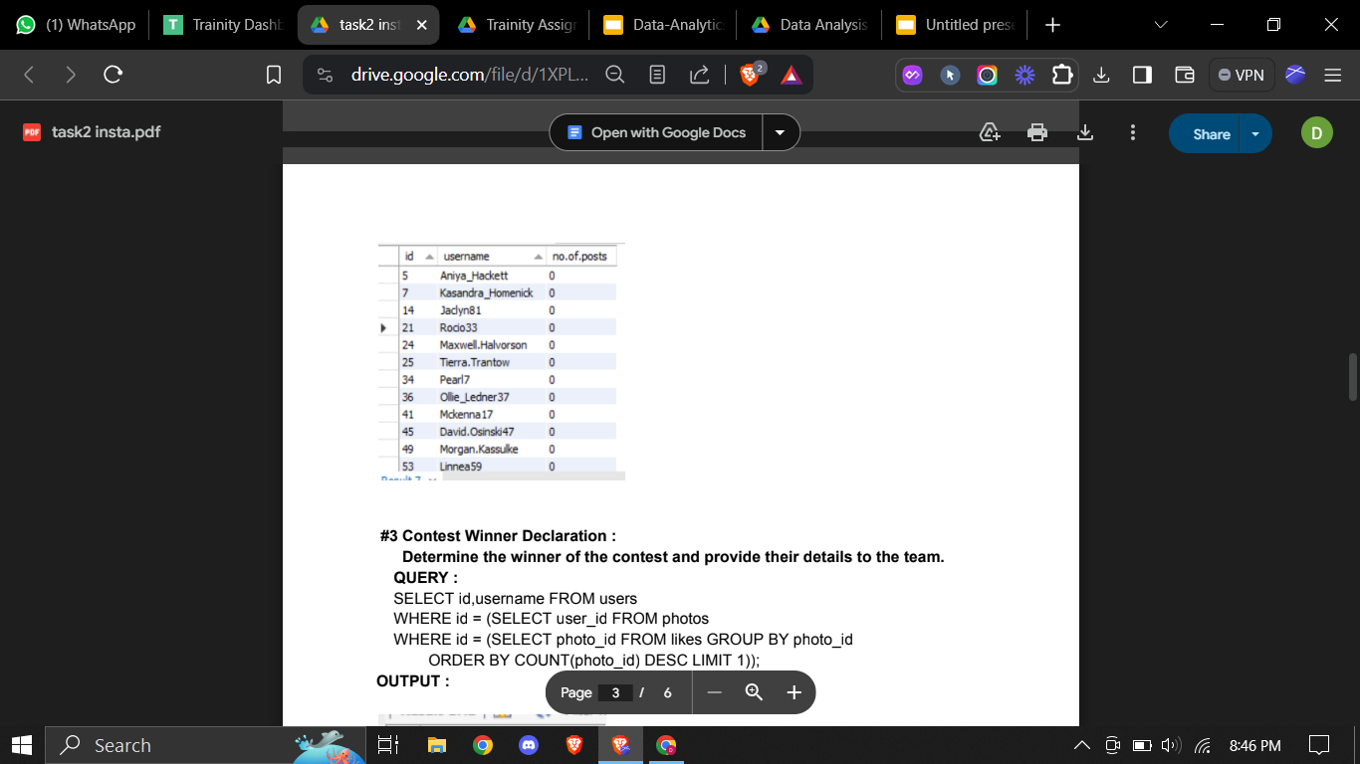
Instagram User Analytics
A)Marketing Analysis :
#1 Loyal User Reward :
Identify the five oldest users on Instagram from the provided database.
A)Marketing Analysis :
#2 Inactive User Engagement :
Identify users who have never posted a single photo on Instagram.

Slide 13
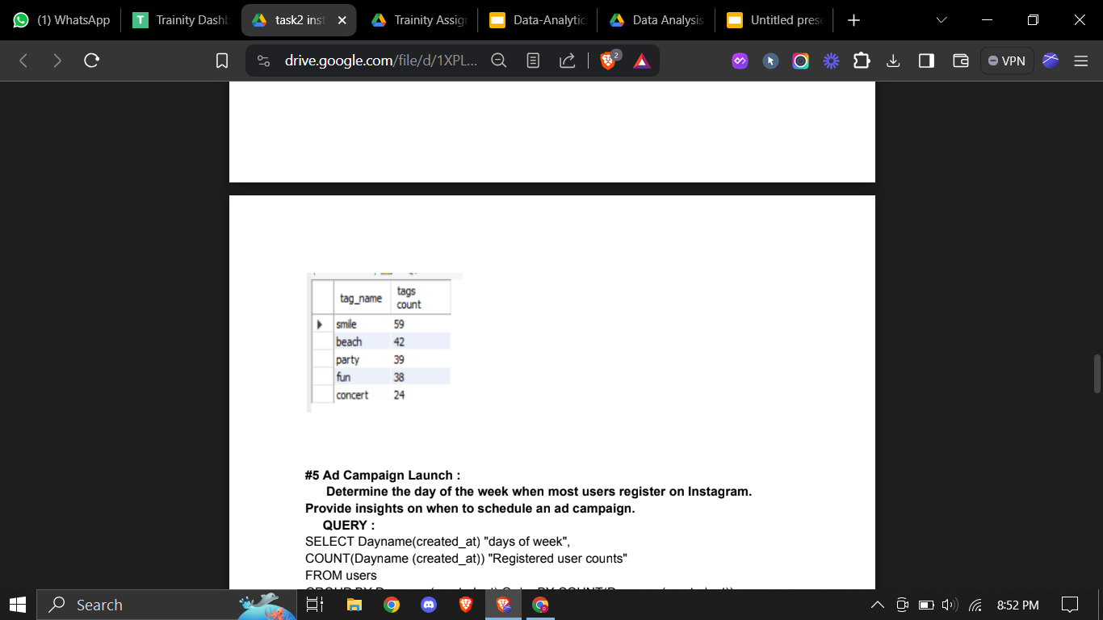
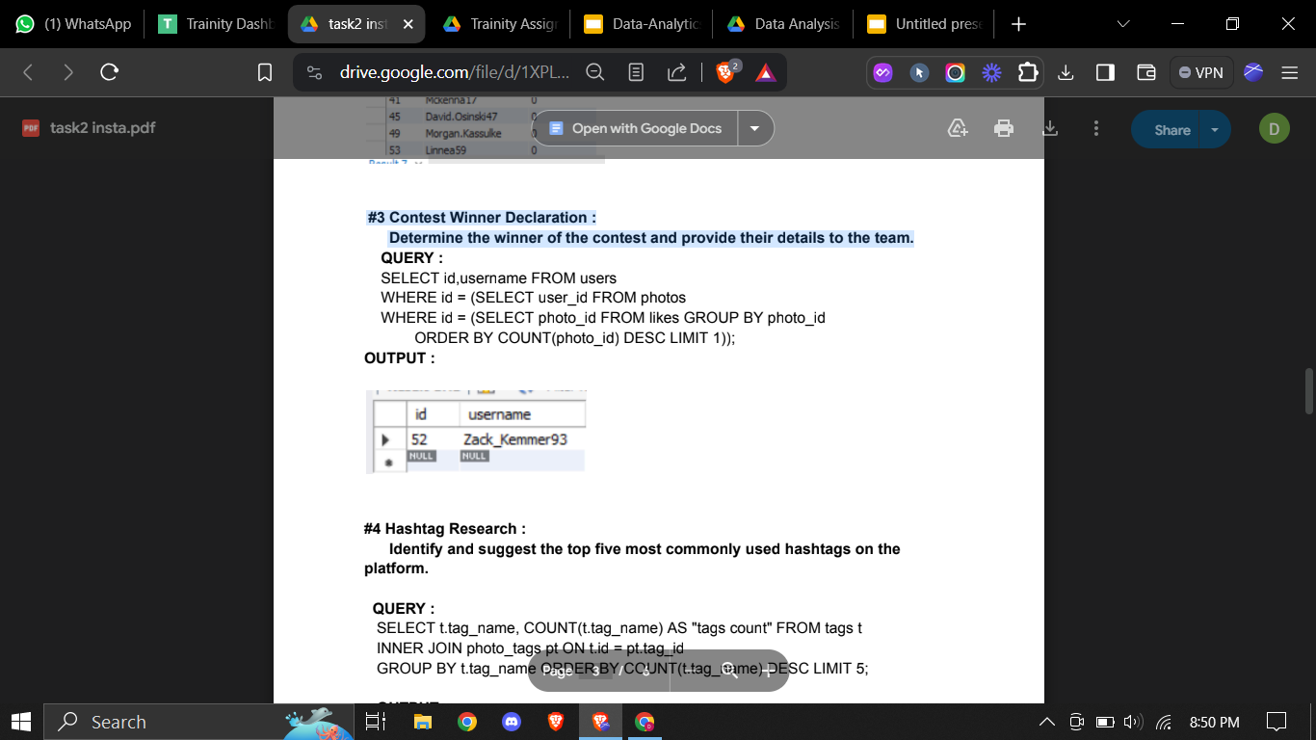
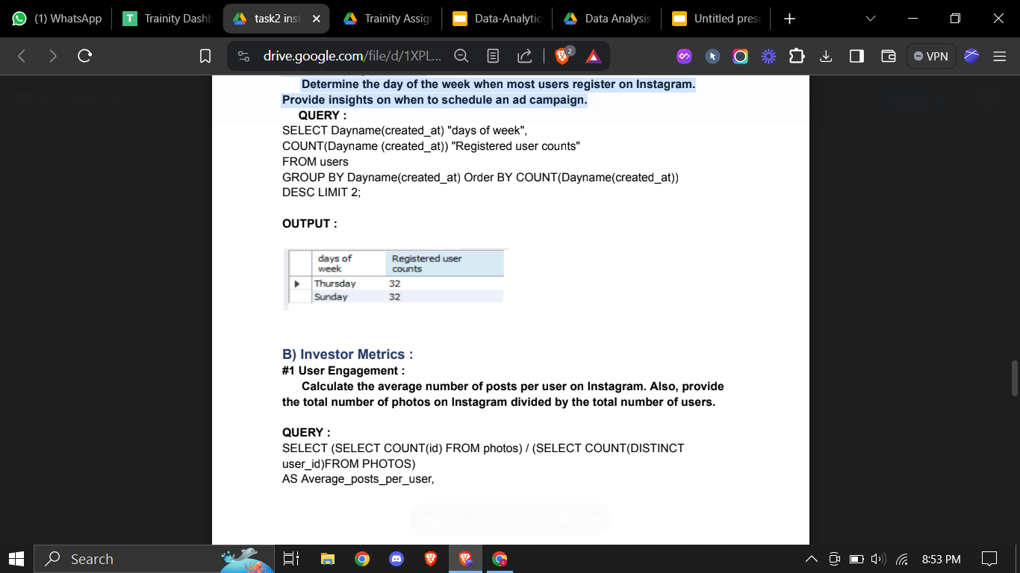
Instagram User Analytics
A)Marketing Analysis :
#3 Contest Winner Declaration :
Determine the winner of the contest and provide their details to the team.
A)Marketing Analysis :
#4 Hashtag Research :
Identify and suggest the top five most commonly used hashtags on the
platform.
A)Marketing Analysis :
#5 Ad Campaign Launch :
Determine the day of the week when most users register on Instagram.
Provide insights on when to schedule an ad campaign.

Slide 14
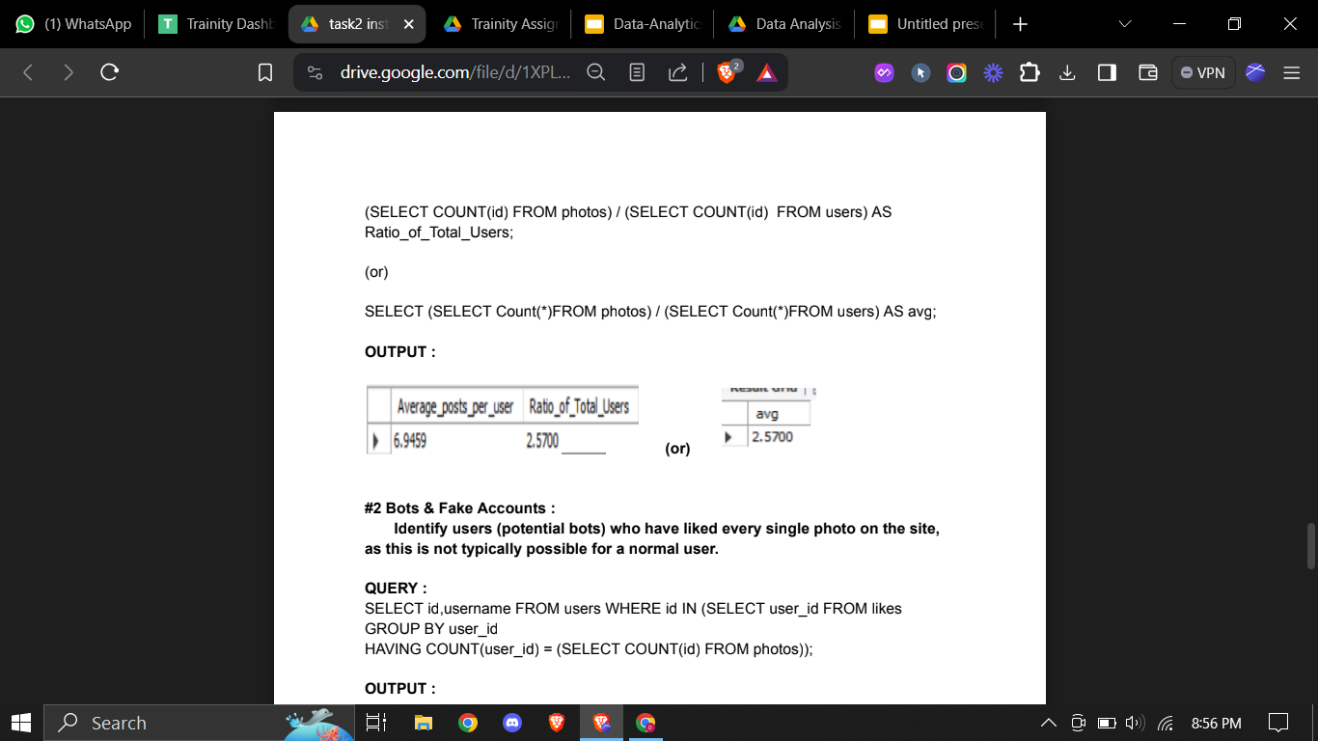
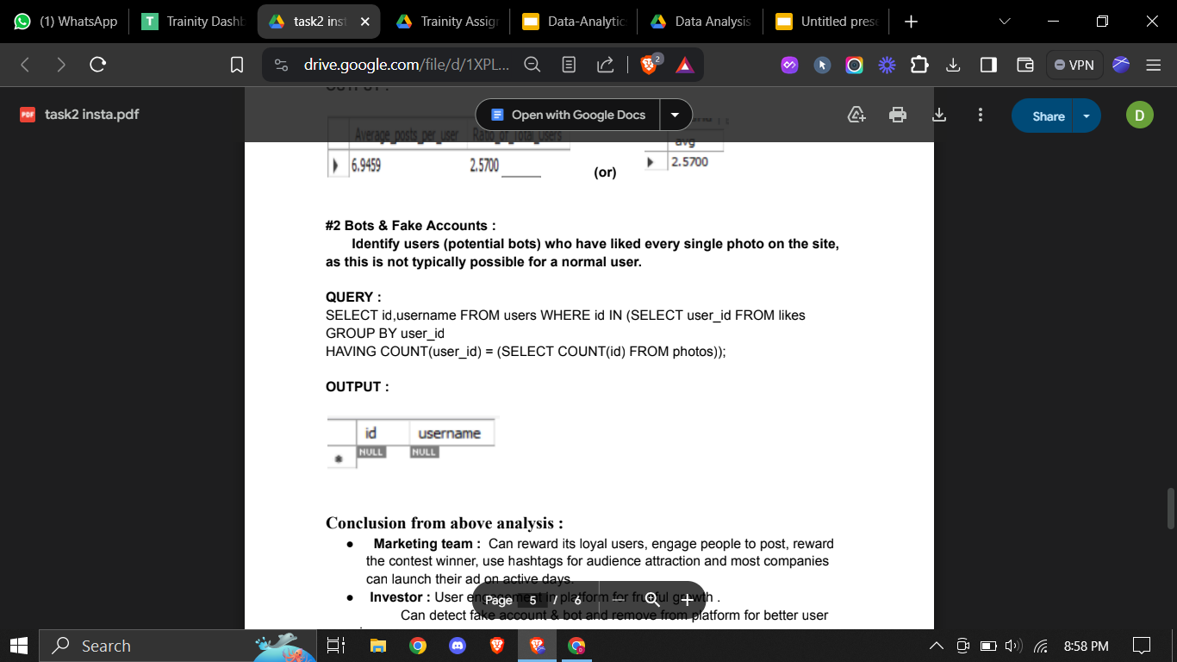
Instagram User Analytics
B) Investor Metrics :
#1 User Engagement :
Calculate the average number of posts per user on Instagram. Also, provide
the total number of photos on Instagram divided by the total number of users.
#2 Bots & Fake Accounts :
Identify users (potential bots) who have liked every single photo on the site,
as this is not typically possible for a normal user.

Slide 15
Instagram User Analytics
Conclusion from above analysis :
Marketing team : Can reward its loyal users, engage people to post, reward the contest winner, use hashtags for audience attraction and most companies can launch their ad on active days.
Investor : User engagement in platform for fruitful growth .
Can detect fake account & bot and remove from platform for better user experience

Slide 16
Operation & Metric Analytics
Project Description :
In today’s data-driven world, businesses need to analyze their operations and metrics to stay competitive. This project aims to provide insights into two different scenarios of operation and metric analytics.
Operational Analytics is a crucial process that involves analyzing a company's end-to-end operations. This analysis helps identify areas for improvement within the company.One of the key aspects of Operational Analytics is investigating metric spikes. This involves understanding and explaining sudden changes in key metrics, such as a dip in daily user engagement or a drop in sales.
One of the primary goals of the project is to provide a dashboard that displays key performance indicators (KPIs). The dashboard will provide a real-time view of KPIs to help managers make data-driven decisions. Both case studies will provide valuable insights into two different scenarios and will enable businesses to make data-driven decisions, improve operational efficiency, and enhance customer satisfaction.

Slide 17

Operation & Metric Analytics
Approach :
Prepare & Analyze
Identify KPIs
Visualize data
CASE STUDY 1:
Operational Analysis of Job data
The first case study involves analyzing job data to improve operational efficiency.
The project finds metrics such as throughput,Productivity and provide recommendations for overall efficiency.
CASE STUDY 2:
Investigating Metric Spike
The second case study involves analyzing product to draw insights and display key performance indicators(KPIs) .
This project helps in analyzing the data to identify patterns and trends as user growth, user engagement,cohort analysis for retention and email metrics.

Slide 18
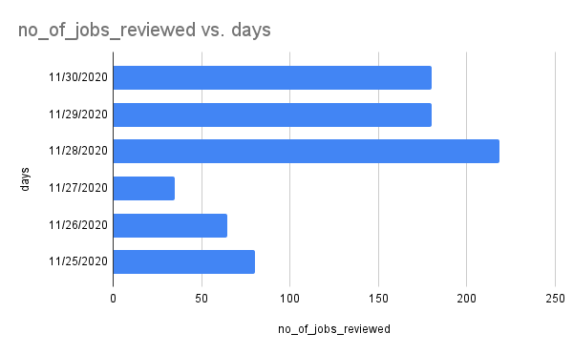
Operation & Metric Analytics
Jobs reviewed over time:
Highest number of jobs were received on 28 NOV of 218 jobs.
Lowest number of jobs were received on 27 NOV of 34 jobs.
On Average of 180 jobs.

Slide 19
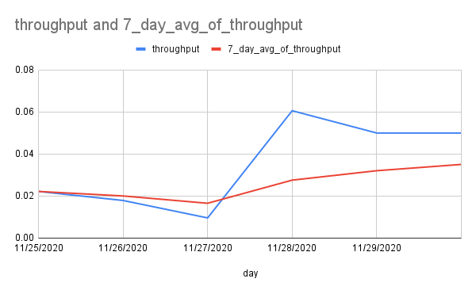
Operation & Metric Analytics
Throughput analysis:
This graph shows the Rolling throughput and 7 day average throughput.
Blue - Throughput
Red - Average
Throughput.

Slide 20
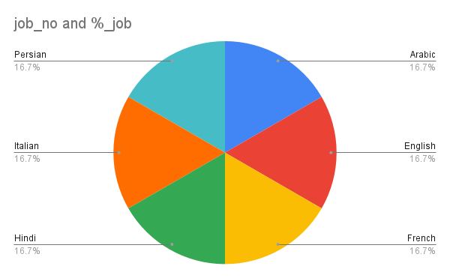
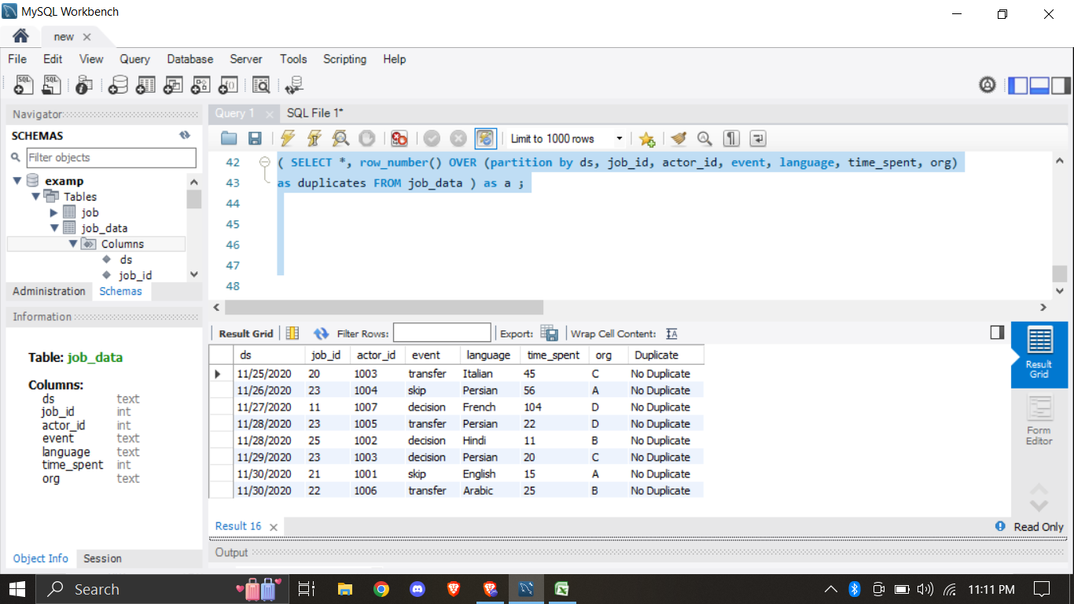
Operation & Metric Analytics
Language share analysis :
Duplicate rows detection :

Slide 21
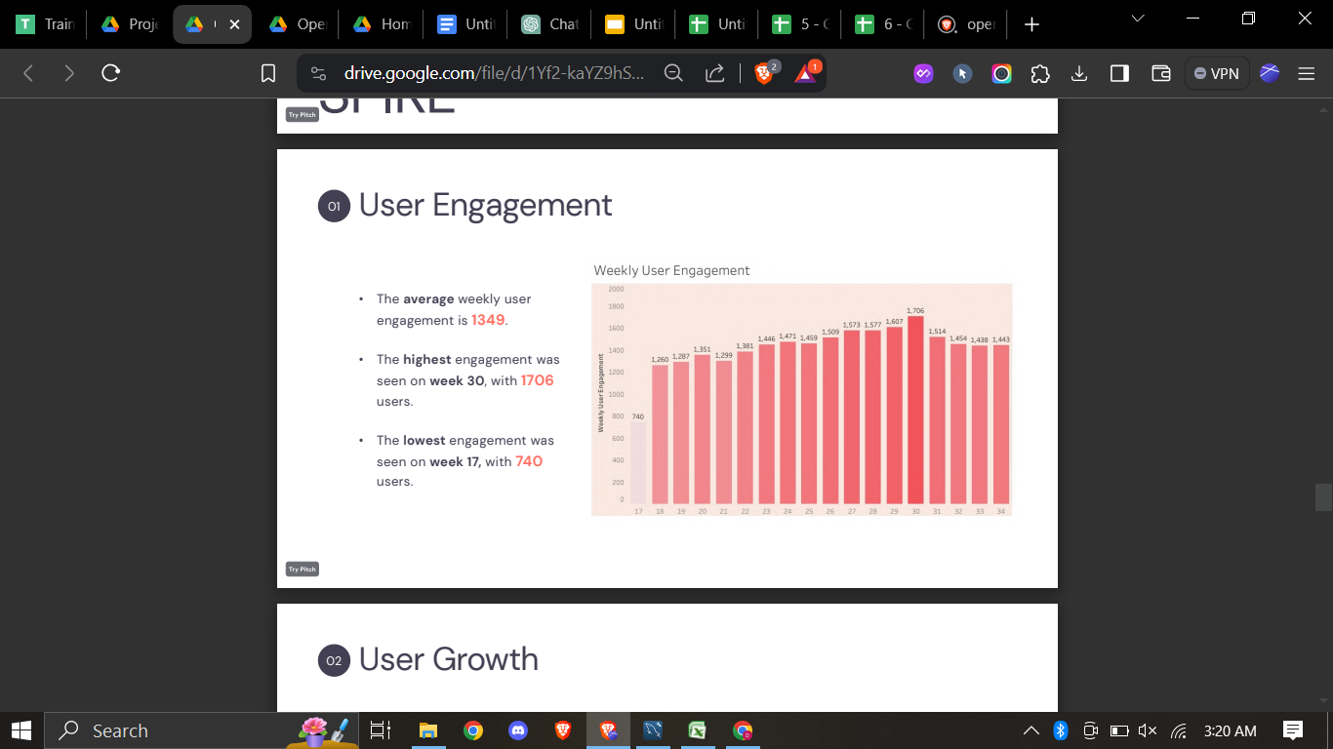
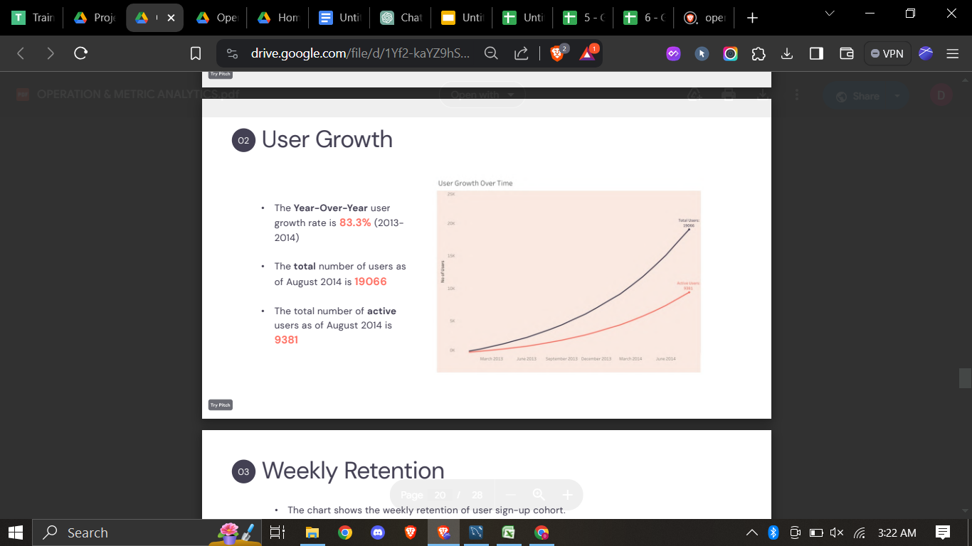
Operation & Metric Analytics
User Engagement:
Objective:
Measure the activeness of users on a weekly basis.
User Growth:
Objective:
Measure the activeness of users on a weekly basis.

Slide 22
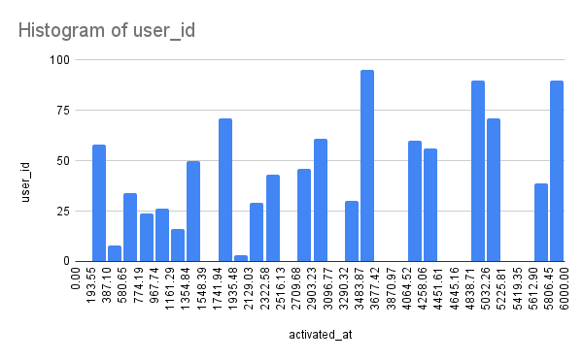
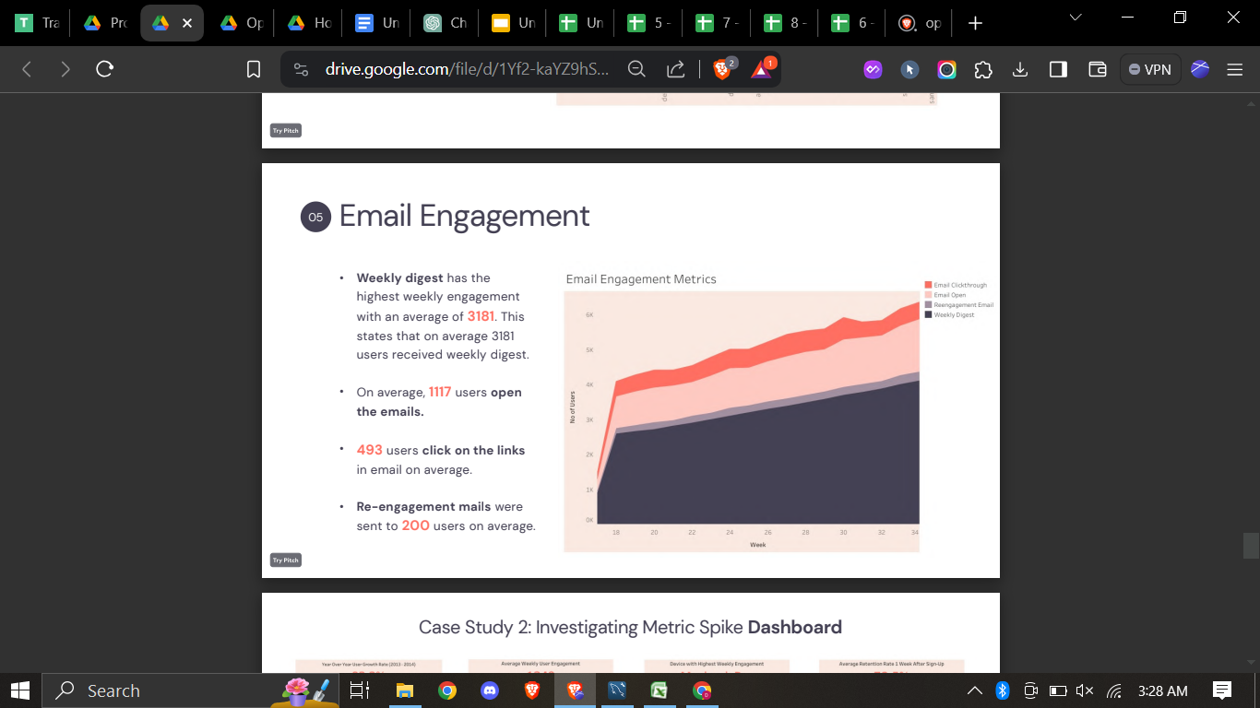
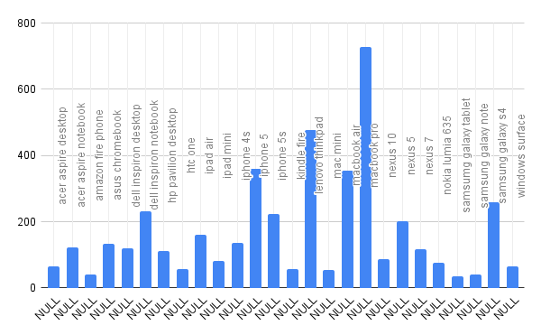
Operation & Metric Analytics
Weekly Retention:
Email Engagement:
Weekly Engagement:

Slide 23
Operation & Metric Analytics
Result :
In this project, I have concluded various results based on the scenario. The provided details with various datasets and tables, and the task is to derive insights from this data to answer questions posed by different departments within the company. My goal is to use the advanced SQL skills to analyze the data and provide valuable insights that can help improve the company's operations and understand sudden changes in key metrics.
Every step was done in a step-by-step process and the insights provided help in declaring and perceiving the result.

Slide 24

Hiring Process Analytics
Project Description :
This project’s aim is to analyze the company's hiring process data and draw meaningful insights from it. The hiring process is a crucial function of any company, and understanding trends such as the number of rejections, interviews, job types, and vacancies can provide valuable insights for the hiring department.
The goal of this project is to use the given statistics dataset in Excel to draw meaningful conclusions about the company's hiring process.
Insights could potentially help the company improve its hiring process and make better hiring decisions in the future.

Slide 25
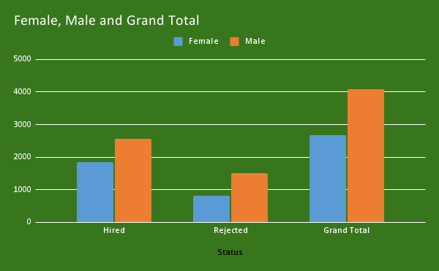
Hiring Process Analytics
The hiring process involves bringing new individuals into the organization for various roles.
Your Task: Determine the gender distribution of hires. How many males and females have been hired by the company?

Slide 26
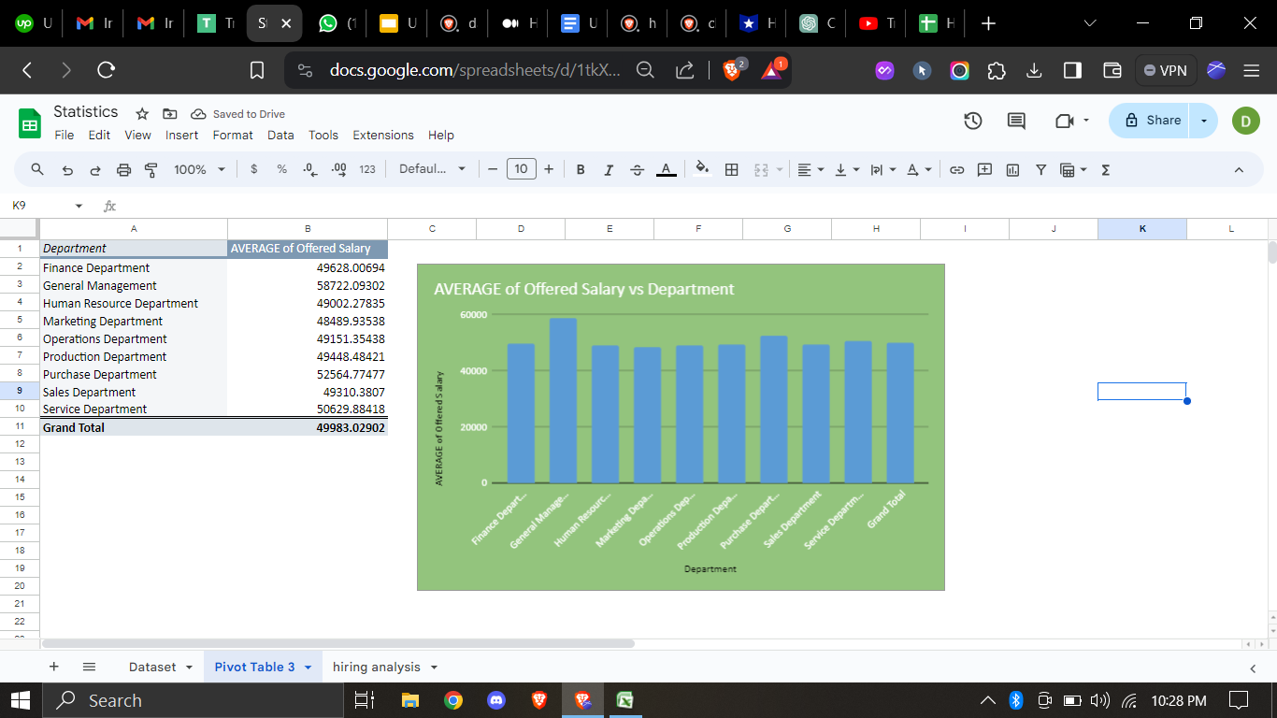
Hiring Process Analytics
The average salary is calculated by adding up the salaries of a group of employees and then dividing the total by the number of employees.
Your Task: What is the average salary offered by this company? Use Excel functions to calculate this.

Slide 27
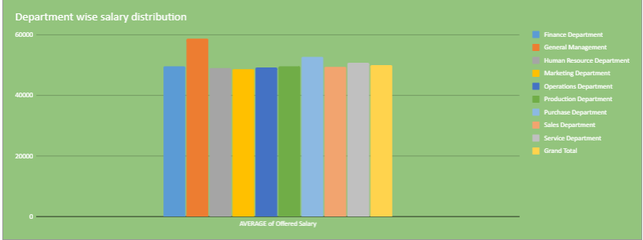
Hiring Process Analytics
Class intervals represent ranges of values, in this case, salary ranges. The class interval is the difference between the upper and lower limits of a class.
Your Task: Create class intervals for the salaries in the company. This will help you understand the salary distribution.

Slide 28
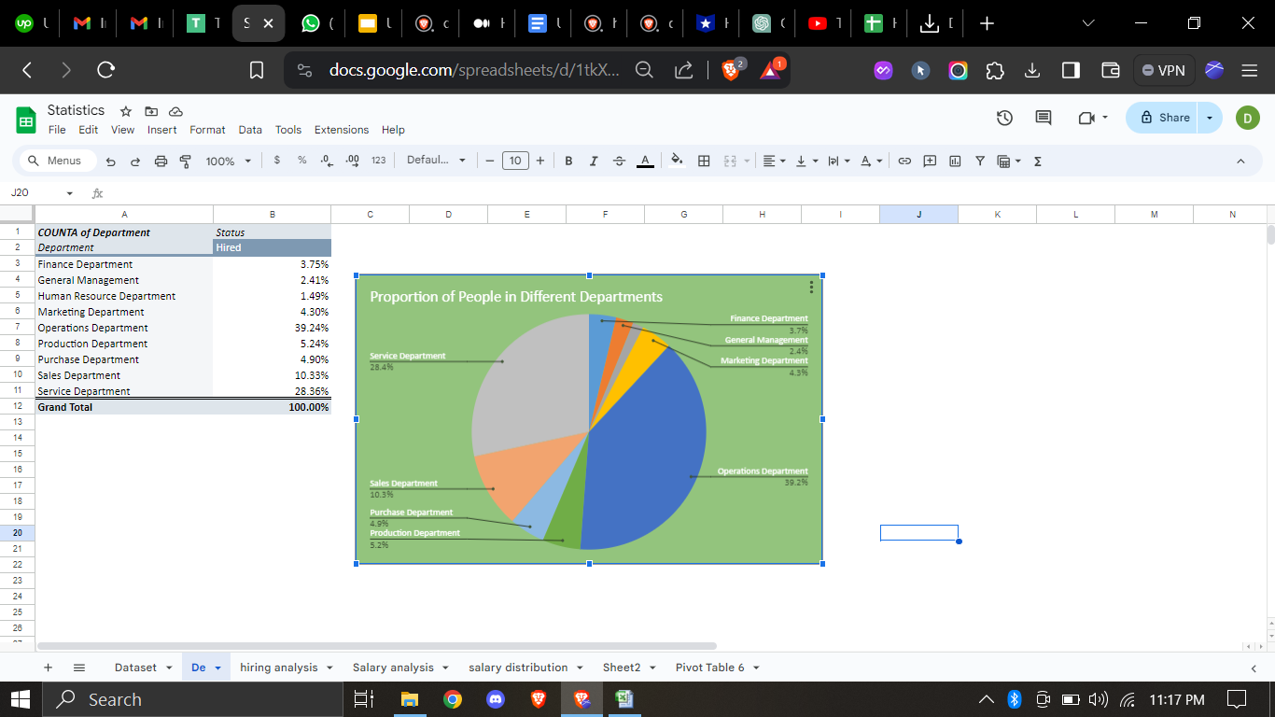
Hiring Process Analytics
Visualizing data through charts and plots is a crucial part of data analysis.
Your Task: Use a pie chart, bar graph, or any other suitable visualization to show the proportion of people working in different departments.

Slide 29
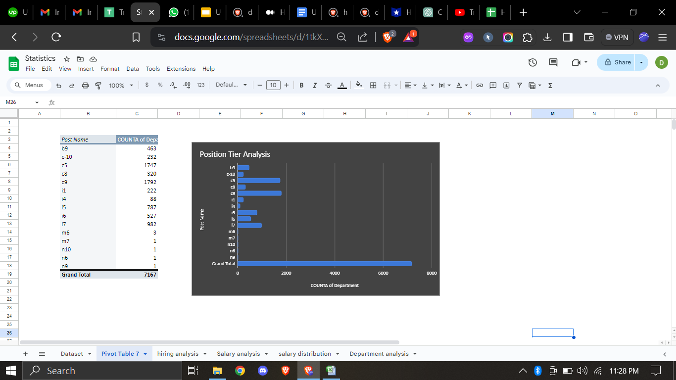
Hiring Process Analytics
Different positions within a company often have different tiers or levels.
Your Task: Use a chart or graph to represent the different position tiers within the company. This will help you understand the distribution of positions across different tiers.

Slide 30
Hiring Process Analytics
Conclusions :
This project helped me in understanding EDA ,Data cleaning and Data extraction.
It is important Data Analytics is for Hiring Process of an organization as it provides valuable insights such as number of rejections, reason for rejections, profile of applicants, vacancies etc. which helps the hiring department to take Data-Driven Decisions.

Slide 31

IMDB Movie Analytics
Project Description :
A potential question for filmmakers to investigate could be: “What factors influence the success of a movie on IMDB?” Here, success can be defined by high IMDB ratings. The impact of this question is significant for movie producers, directors, and investors who want to understand what makes a movie successful to make informed decisions in their future projects
This Project is about giving insights about success of a Movie based on IMDB data provided which will be helpful for filmmakers and other stakeholders during production of a movie.

Slide 32
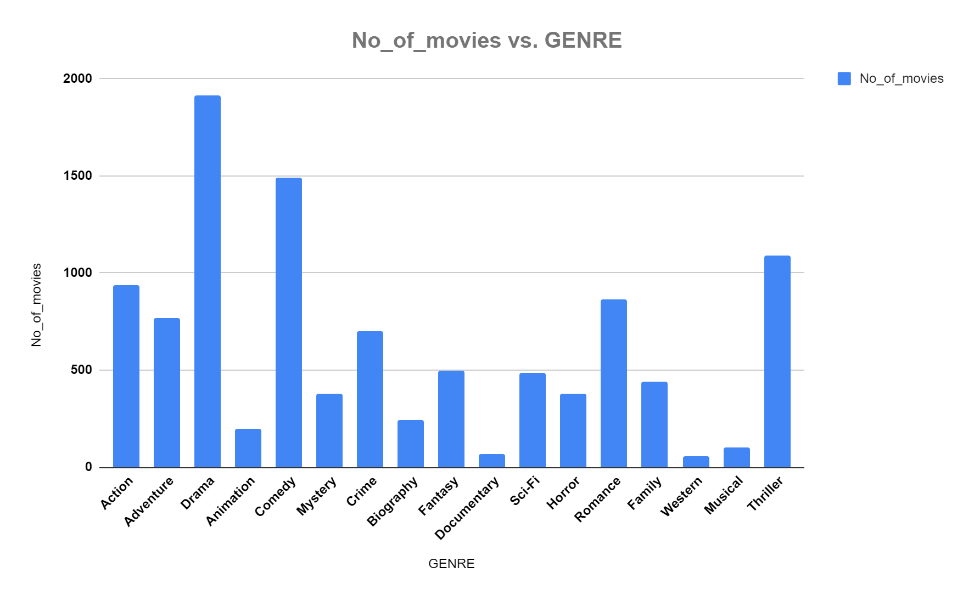
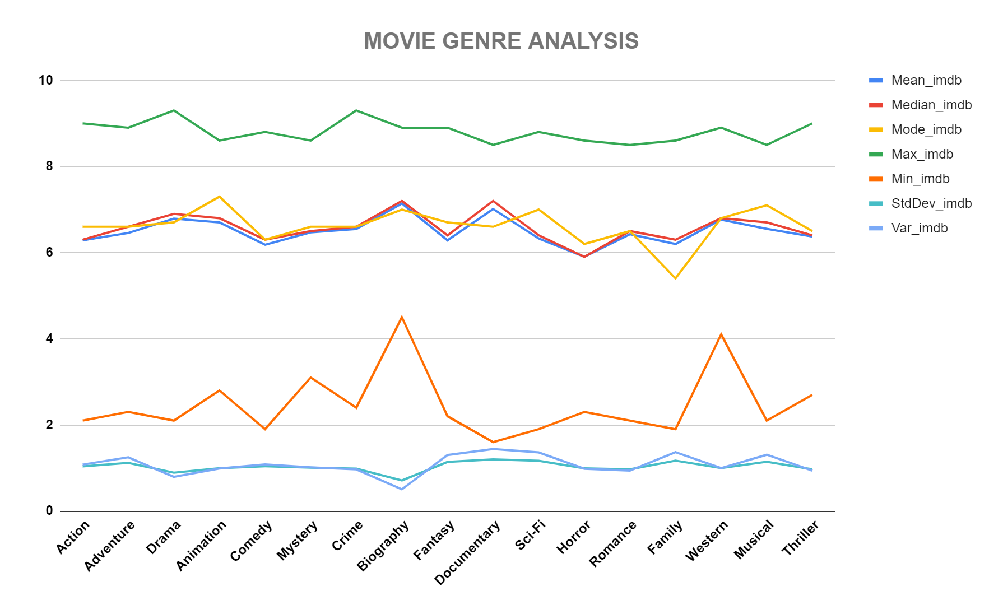
IMDB Movie Analytics
Movie Genre Analysis
Analyze the distribution of movie genres and their impact on the IMDB score.
Task: Determine the most common genres of movies in the dataset. Then, for each genre, calculate descriptive statistics (mean, median, mode, range, variance, standard deviation) of the IMDB scores.
Result: The top 7 most common genres are Drama, Comedy, Thriller, Action, Romance, Adventure and Crime. Also all the top 7 genres’ descriptive statistics are almost at same level.

Slide 33
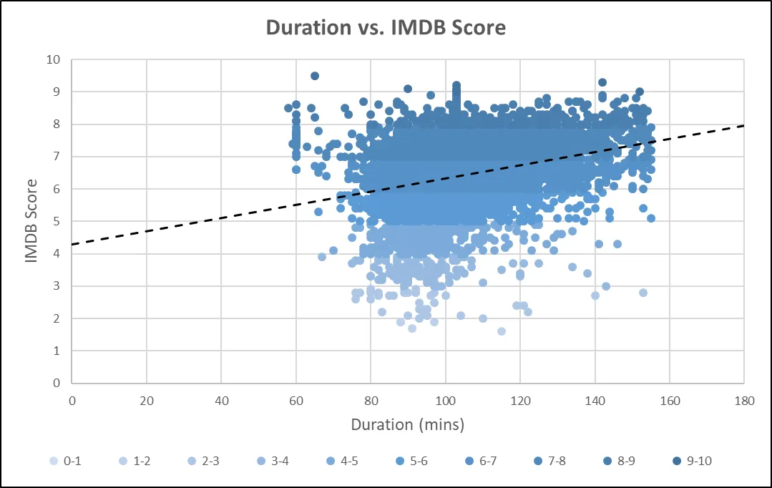
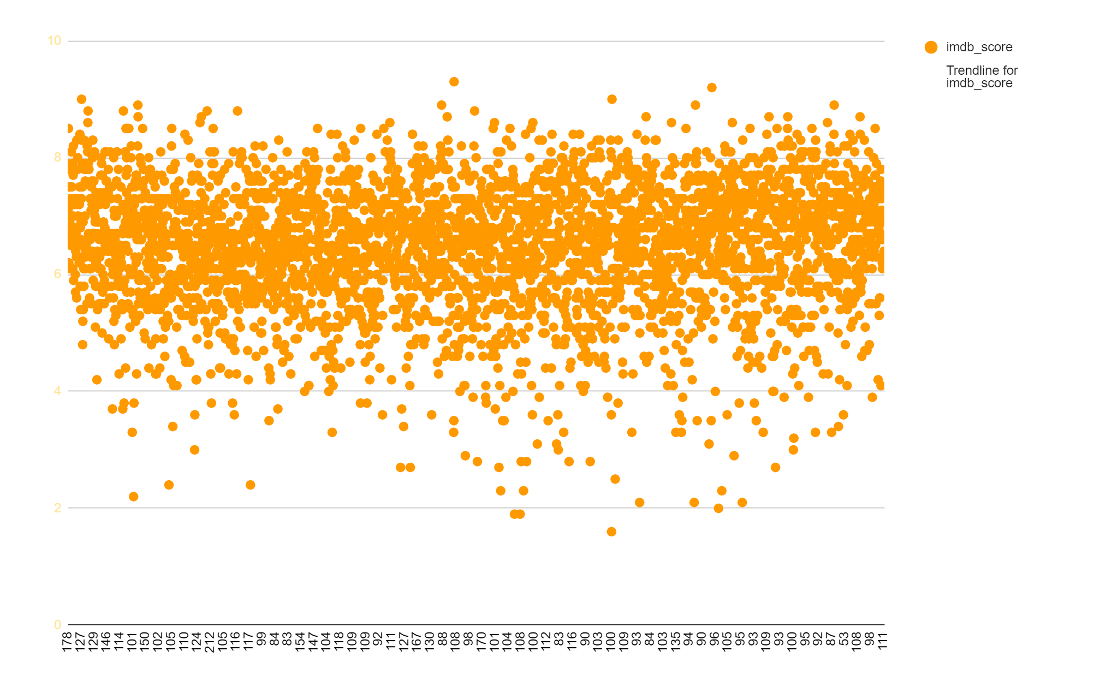
IMDB Movie Analytics
Movie Duration Analysis
Analyze the distribution of movie durations and its impact on the IMDB score.
Task: Analyze the distribution of movie durations and identify the relationship between movie duration and IMDB score.
Result: The distribution of Movie Durations shows that it closely follows a Normal Distribution. Also the scatter plot shows that duration and imdb_scores have a positive relationship.

Slide 34
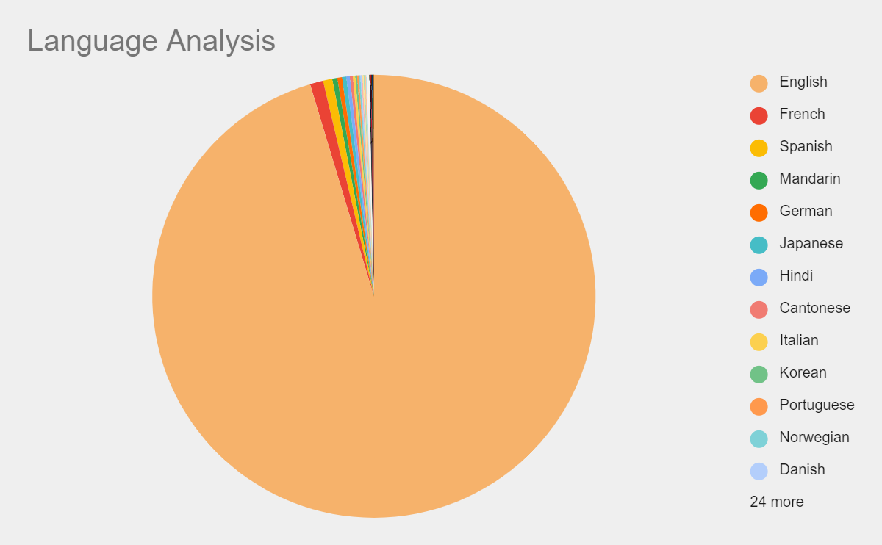
IMDB Movie Analytics
Language Analysis
Situation: Examine the distribution of movies based on their language.
Task: Determine the most common languages used in movies and analyze their impact on the IMDB score using descriptive statistics.
Result: The left plot show that English is the most common language used in movies followed by French, Spanish, Hindi and Mandarin. The right plot shows that French language has comparatively higher mean and median but lower variance and standard deviation implying that most of the French language movies have their imdb score on the higher side.

Slide 35
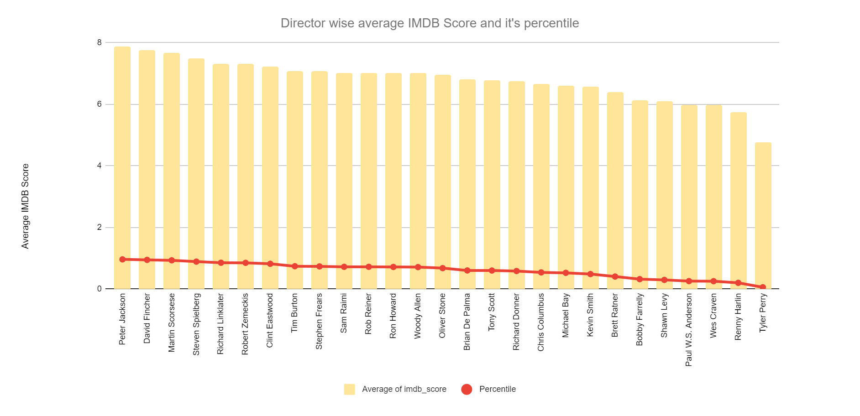
IMDB Movie Analytics
Director Analysis
Influence of directors on movie ratings.
Task: Identify the top directors based on their average IMDB score and analyze their contribution to the success of movies using percentile calculations.
Result: The plot considers only those directors whose movie counts are more than 9 and the range of IMDB Scores is less than equal to 3 as otherwise it would be unfair for those who has maintained consistently high scores for large number of movies to be compared for top directors to those who has performed well in few movies.

Slide 36
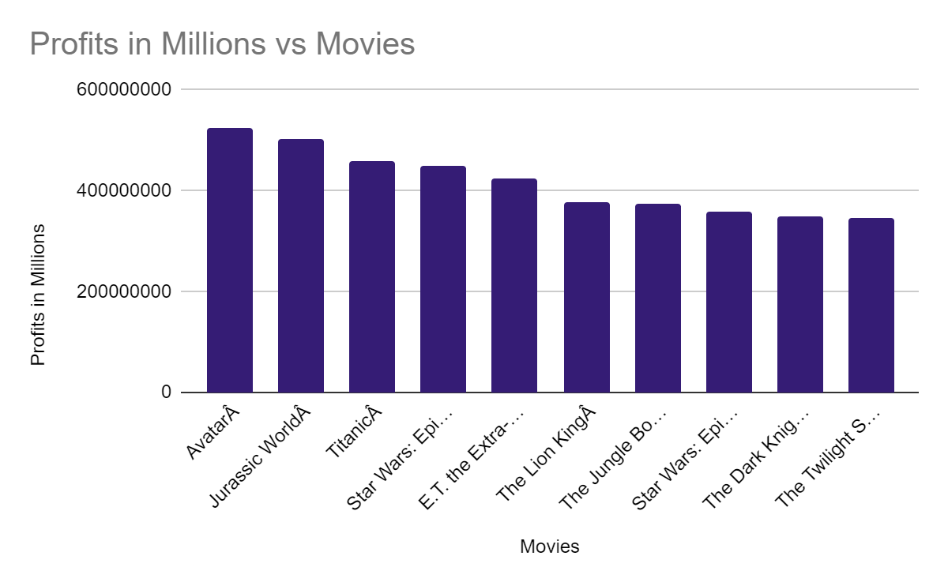
IMDB Movie Analytics
Budget Analysis
Explore the relationship between movie budgets and their financial success.
Task: Analyze the correlation between movie budgets and gross earnings, and identify the movies with the highest profit margin.
Result: The table shows that the correlation between Gross and Budget is positive and more than 0.5. That is, the relationship shows that as budget of movies increase, there is a very high probability that the gross collection of the movie will also increase. The plot shows the relationship between Gross and Budget. The overall trendline has a slope close to 1.

Slide 37
IMDB Movie Analytics
Result :
Through this project, I was able to understand the importance of Data Analytics in Movies analysis as it provides valuable insights such as director’s relationship with IMDB Score, genre’s relationship with IMDB Score, budget’s relationship with IMDB Score etc. which helps in making Data-Driven Decisions.
This helps in better usage and handling of data in excel and it provide a strong foundation on it too..

Slide 38

Bank Loan Case Study
Project Description :
Imagine you're a data analyst at a finance company that specializes in lending various types of loans to urban customers. Your company faces a challenge: some customers who don't have a sufficient credit history take advantage of this and default on their loans. Your task is to use Exploratory Data Analysis (EDA) to analyze patterns in the data and ensure that capable applicants are not rejected.
The case study is given with three datasets:
Previous_data previous_dataset
Application_data application_dataset
Column_data column data

Slide 39
Bank Loan Case Study
Company’s Perspective :
When a customer applies for a loan, your company faces two risks:
If the applicant can repay the loan but is not approved, the company loses business.
If the applicant cannot repay the loan and is approved, the company faces a financial loss.
Two types of scenarios:
Customers with payment difficulties: These are customers who had a late payment of more than X days on at least one of the first Y installments of the loan.
All other cases: These are cases where the payment was made on time.
When a customer applies for a loan, there are four possible outcomes:
Approved: The company has approved the loan application.
Cancelled: The customer cancelled the application during the approval process.
Refused: The company rejected the loan.
Unused Offer: The loan was approved but the customer did not use it.

Slide 40
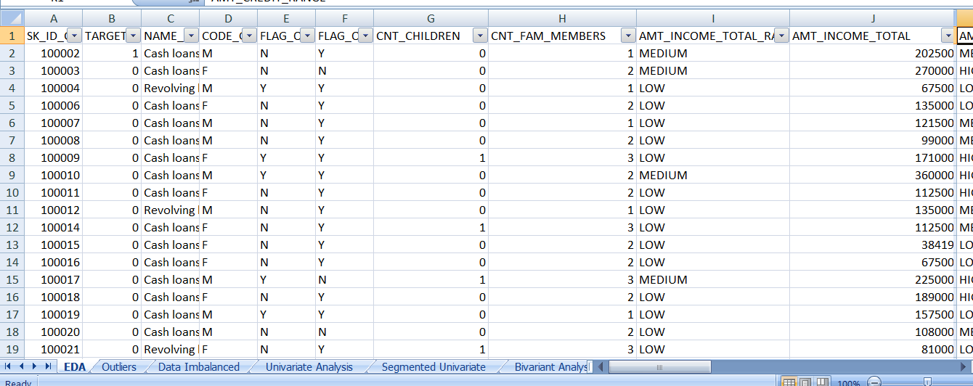
Bank Loan Case Study
Identify Missing Data and Deal with it Appropriately: As a data analyst, you come across missing data in the loan application dataset. It is essential to handle missing data effectively to ensure the accuracy of the analysis.
Task: Identify the missing data in the dataset and decide on an appropriate method to deal with it using Excel built-in functions and features.

Slide 41
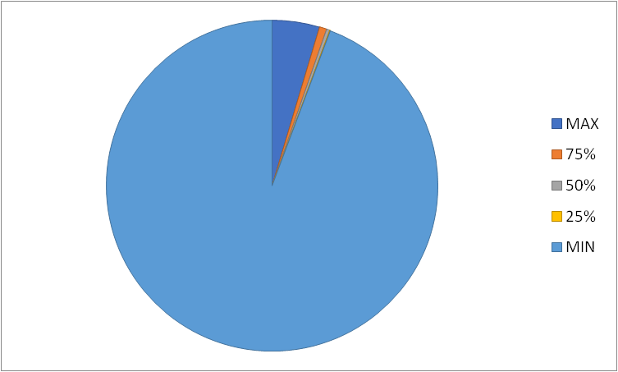
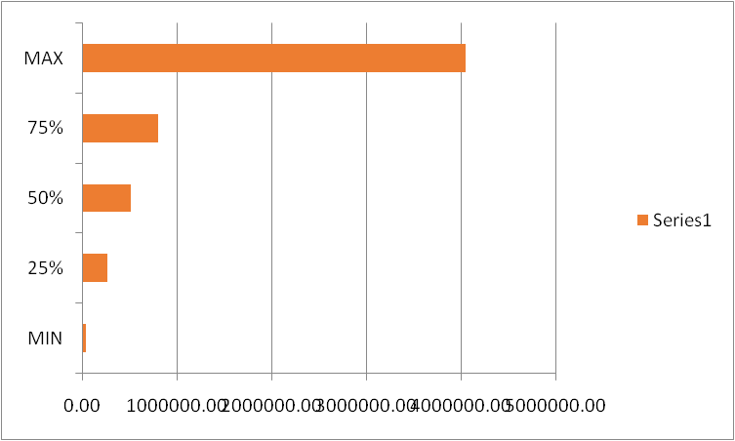
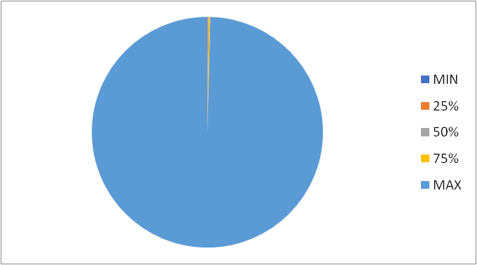
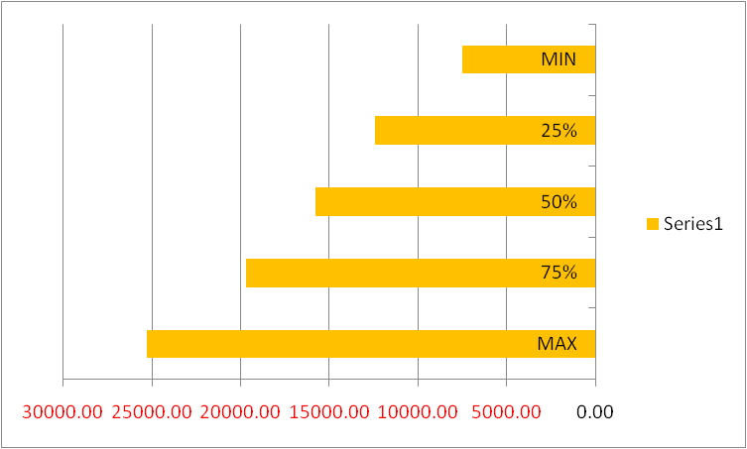
Bank Loan Case Study
Identify Outliers in the Dataset: Outliers can significantly impact the analysis and distort the results. You need to identify outliers in the loan application dataset.
Task: Detect and identify outliers in the dataset using Excel statistical functions and features, focusing on numerical variables.

Slide 42
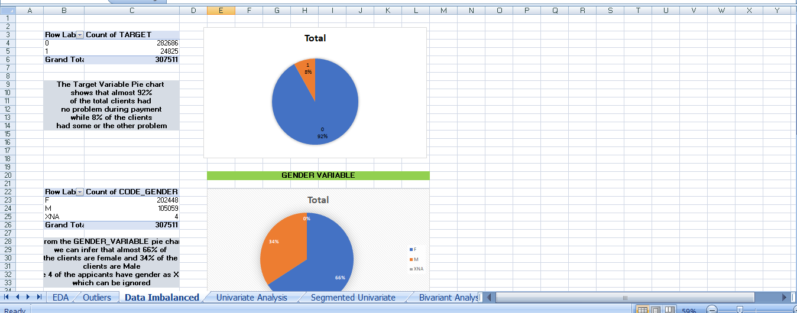
Bank Loan Case Study
Analyze Data Imbalance: Data imbalance can affect the accuracy of the analysis, especially for binary classification problems. Understanding the data distribution is crucial for building reliable models.
Task: Determine if there is data imbalance in the loan application dataset and calculate the ratio of data imbalance using Excel functions.

Slide 43
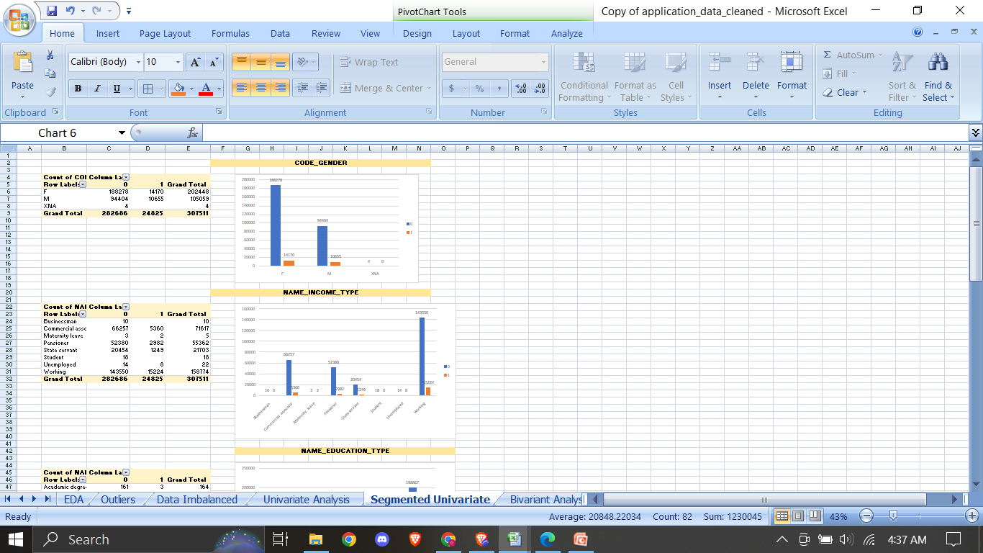
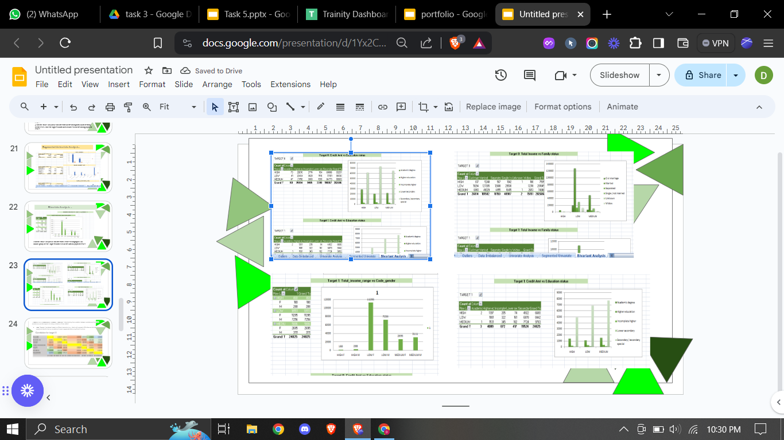
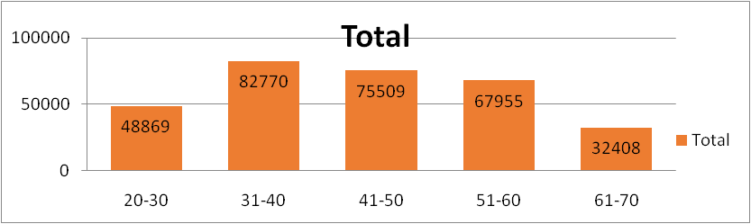
Bank Loan Case Study
Perform Univariate, Segmented Univariate, and Bivariate Analysis: To gain insights into the driving factors of loan default, it is important to conduct various analyses on consumer and loan attributes.Task: Perform univariate analysis to understand the distribution of individual variables, segmented univariate analysis to compare variable distributions for different scenarios, and bivariate analysis to explore relationships between variables and the target variable using Excel functions and features.

Slide 44
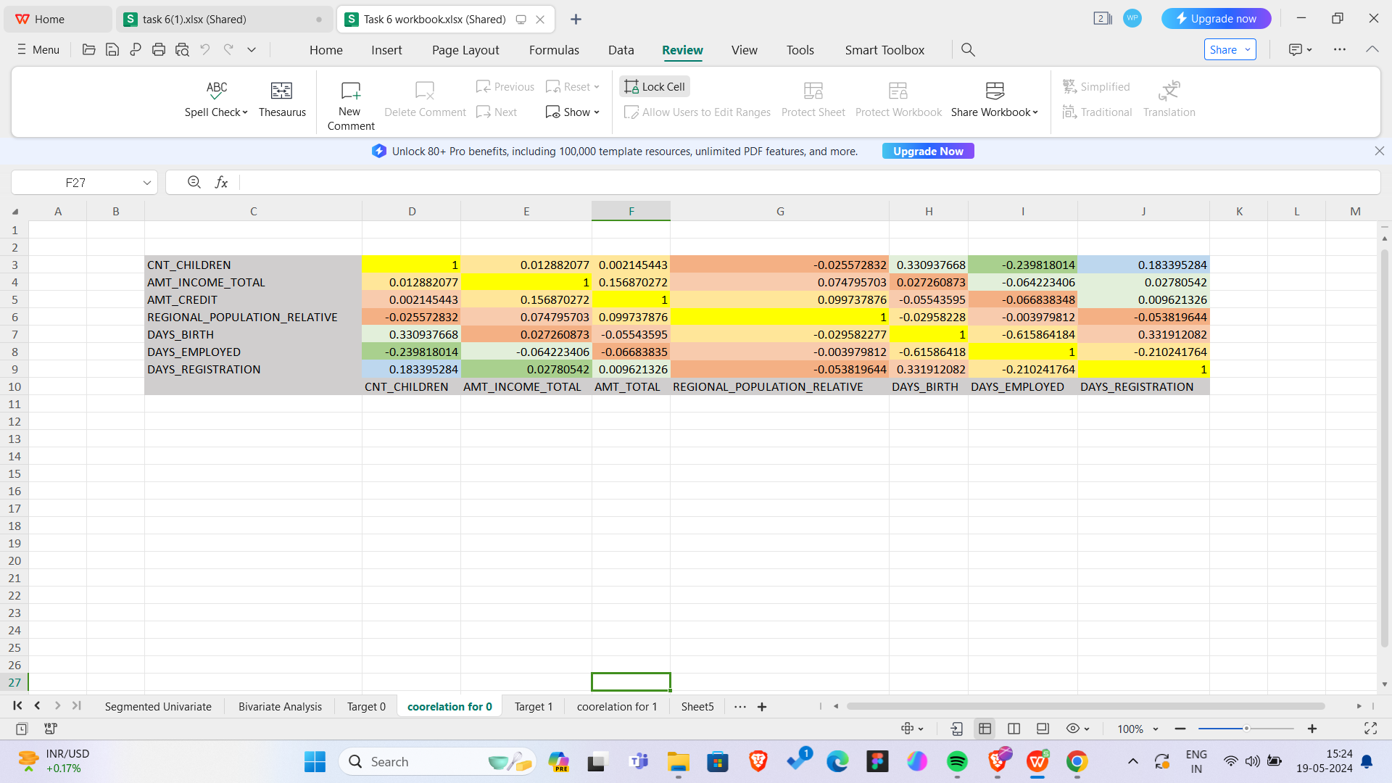
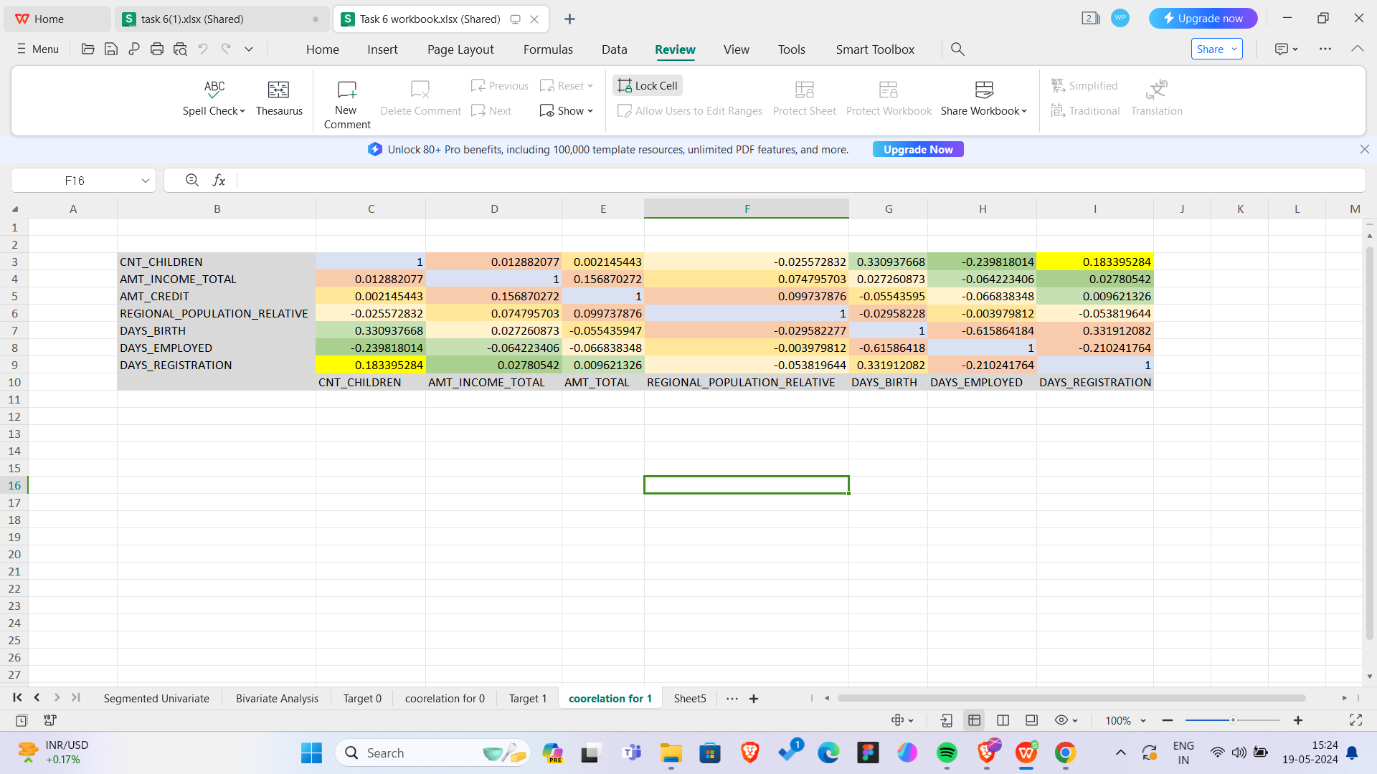
Bank Loan Case Study
Identify Top Correlations for Different Scenarios: Understanding the correlation between variables and the target variable can provide insights into strong indicators of loan default.
Task: Segment the dataset based on different scenarios (e.g., clients with payment difficulties and all other cases) and identify the top correlations for each segmented data using Excel functions.

Slide 45
Bank Loan Case Study
Result :
Hence the analysis are being done on both datasets Applications Dataset and Precious Applications Dataset
The following conclusions were drawn from the analysis done
The proportion/percentage of the defaulters(target = 1) is around 8% and that of non-defaulters(target = 0) is around 92%
The Bank generally lends more loan to Female clients as compared to Males clients as the count of Female clients in the defaulter’s list is less than that of Males. Still Bank can look for more Male clients if their credit amount is satisfied
Also the clients who belong to Working class tend to pay their loans on time followed by the clients who fall under Commercial Associate
Clients having Education status like Secondary/ Higher Secondary or more tend to pay loan on time so bank can prefer lending loans to clients having such Education Status
Clients who fall in the Age Group 31-40 have the highest count for paying off their loans on time followed by the clients who fall in the Age Groups 41-60
Clients having LOW credit amount range tend to pay off their loans on time than compared to HIGH and MEDIUM credit range
Clients living with their Parents tend to pay off their loans quickly as compared to other housing type. So Bank can lend loan to clients having housing type à Living with Parents

Slide 46
Impact of Car Features
Project Description :
The automotive industry has been rapidly evolving over the past few decades, with a growing focus on fuel efficiency, environmental sustainability, and technological innovation. With increasing competition among manufacturers and a changing consumer landscape, it has become more important than ever to understand the factors that drive consumer demand for cars.
In recent years, there has been a growing trend towards electric and hybrid vehicles and increased interest in alternative fuel sources such as hydrogen and natural gas. At the same time, traditional gasoline-powered cars remain dominant in the market, with varying fuel types and grades available to consumers.
The client has asked How can a car manufacturer optimize pricing and product development decisions to maximize profitability while meeting consumer demand?
As a Data Analyst., this problem could be approached by analyzing the relationship between a car's features, market category, and pricing, and identifying which features and categories are most popular among consumers and most profitable for the manufacturer. By using data analysis techniques such as regression analysis and market segmentation, the manufacturer could develop a pricing strategy that balances consumer demand with profitability, and identify which product features to focus on in future product development efforts. This could help the manufacturer improve its competitiveness in the market and increase its profitability over time.

Slide 47
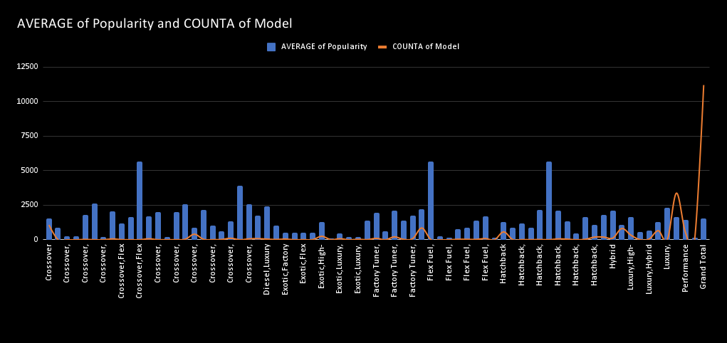
Impact of Car Features
Insight Required: How does the popularity of a car model vary across different market categories?
Task 1.A: Create a pivot table that shows the number of car models in each market category and their corresponding popularity scores.
Task 1.B: Create a combo chart that visualizes the relationship between market category and popularity.
We can observe that the average popularity of cars based on their Market Category mainly ranges from 1200 to 1800 with the exception of Exotic cars being lowest and most popular.
The dataset has comparatively higher number of Performance and Luxury cars followed by Crossovers and Flex Fuel.

Slide 48
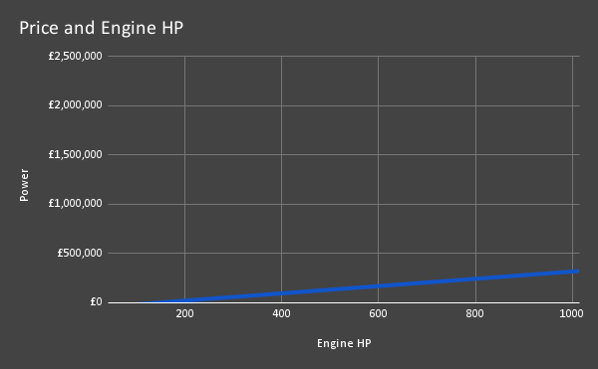
Impact of Car Features
nsight Required: What is the relationship between a car's engine power and its price?
Task 2: Create a scatter chart that plots engine power on the x-axis and price on the y-axis. Add a trendline to the chart to visualize the relationship between these variables.
We can observe that the relationship is positive as the trendline has positive slope. This is logical as higher Engine HP requires more complex level of design and engineering and more expensive sub-parts. Also cars with higher Engine HP are mostly Performance

Slide 49
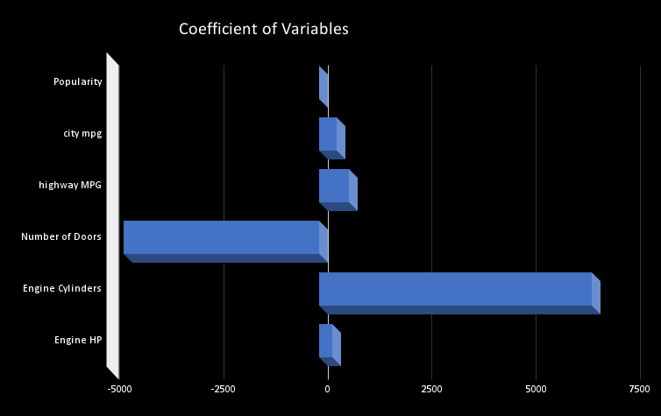
Impact of Car Features
Insight Required: Which car features are most important in determining a car's price?
Task 3: Use regression analysis to identify the variables that have the strongest relationship with a car's price. Then create a bar chart that shows the coefficient values for each variable to visualize their relative importance.
Using regression analysis, we found the top columns. This also include two new columns which were Feature Engineered (Engine HP/city mpg) and (1/(highway MPG + city mpg)).
We can observe that the R-Squared score is 0.7 which can be counted as a good score
.We can observe that the highest coefficient value is that of Engineered Feature, 1/(highway MPG + city mpg).
This shows that the Engineered Feature is very important relationship with Car’s price.

Slide 50
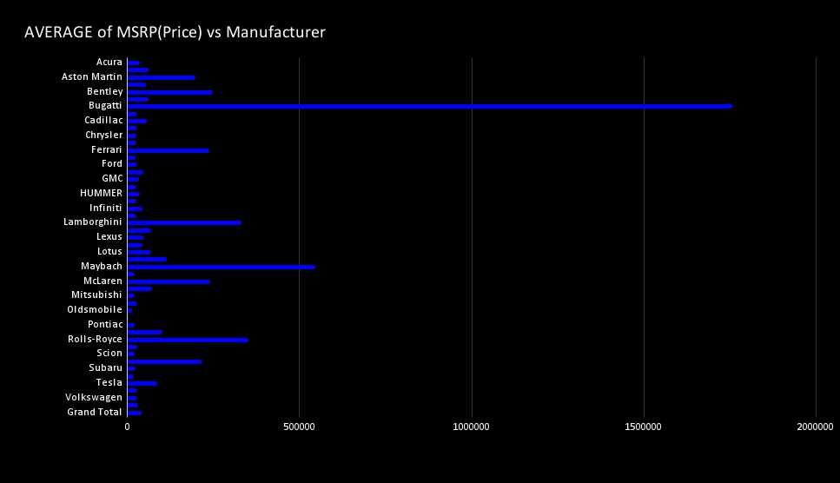
Impact of Car Features
Insight Required: How does the average price of a car vary across different manufacturers?
Task 4.A: Create a pivot table that shows the average price of cars for each manufacturer.
Task 4.B: Create a bar chart or a horizontal stacked bar chart that visualizes the relationship between manufacturer and average price.
We can observe that the most expensive cars are that of Bugatti brand followed by Maybach, Rolls-Royce, Lamborghini etc. All these cars brands are High-Performance and Luxury brands.

Slide 51
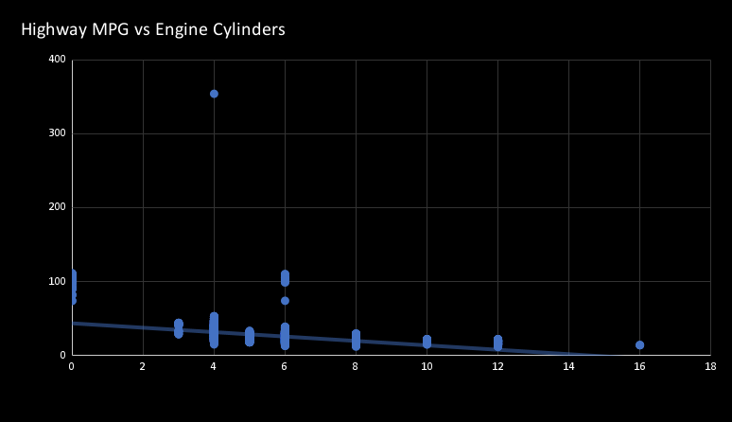
Impact of Car Features
Insight Required: What is the relationship between fuel efficiency and the number of cylinders in a car's engine?
Task 5.A: Create a scatter plot with the number of cylinders on the x-axis and highway MPG on the y-axis. Then create a trendline on the scatter plot to visually estimate the slope of the relationship and assess its significance.
Task 5.B: Calculate the correlation coefficient between the number of cylinders and highway MPG to quantify the strength and direction of the relationship.
We can observe that the plot between highway MPG and Engine Cylinders has a negative slope with a value of -3.2224.
The correlation coefficient is also Negative with a value of -0.596244819
This is logical because as number of Engine Cylinders increases, the amount of fuel to be burnt also increasing, thus decreasing the mileage (highway MPG).

Slide 52

Impact of Car Features
Building the Dashboard:
Now for the Next portion of the Project, you need to create the Interactive Dashboard.
Use filters and slicers to make the chart interactive. The client has requested these questions given below:

Slide 53
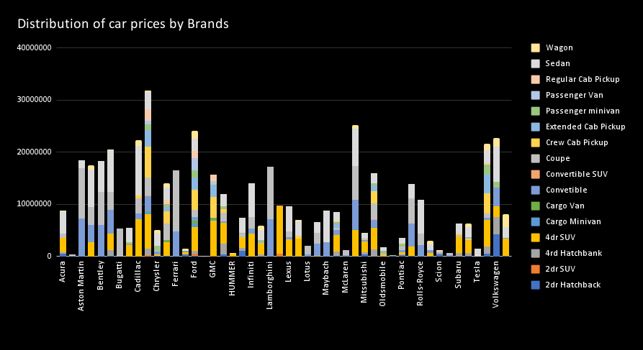
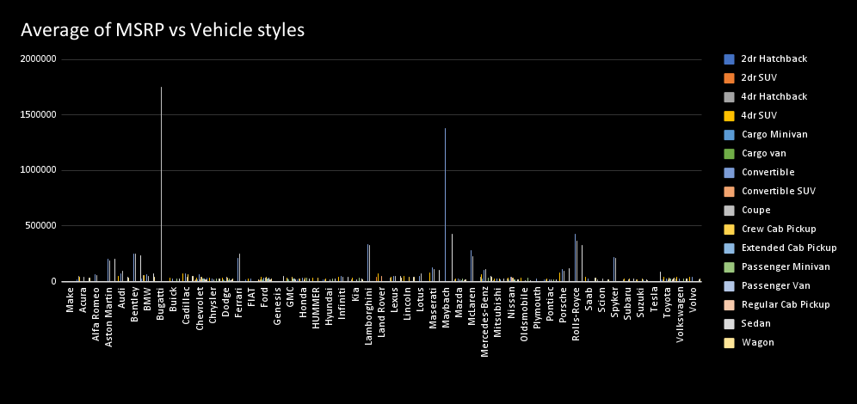
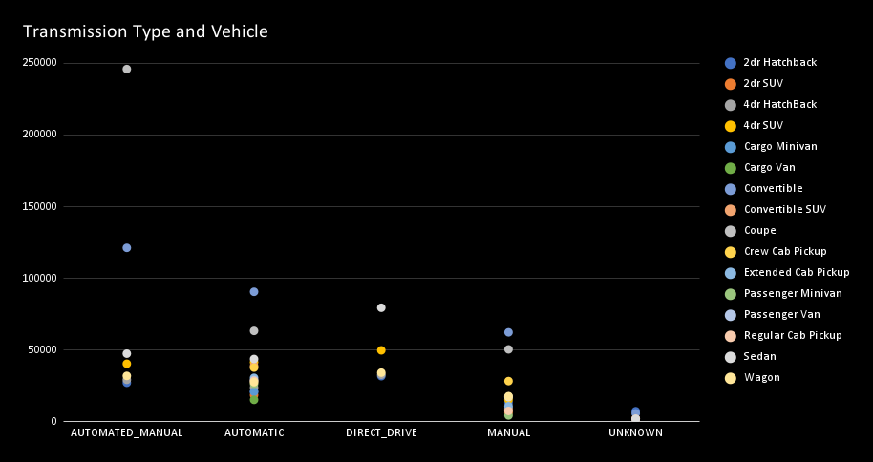
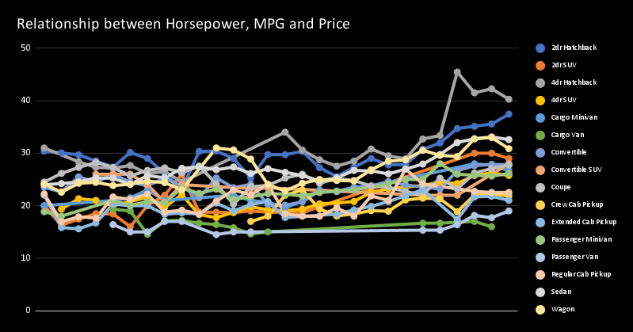
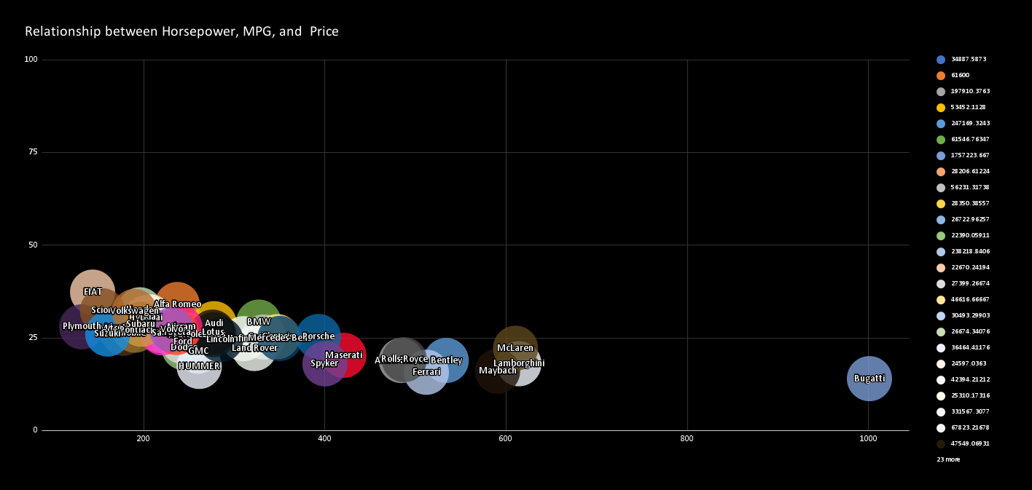
Impact of Car Features

Slide 54
Impact of Car Features
Conclusion :
Through this project, I was able to understand the importance of Data Analytics in Car Feature Analysis as it provides valuable insights which helps in making Data-Driven Decisions.
In this project I was able to get insights like which features effects Car Price, relationship between Engine Cylinders and it’s fuel efficiency etc. I also got experience in Data Preprocessing like Data Cleaning, handling Outliers, Feature Engineering etc. in this project which can be communicated to relevant stakeholders as per the requirements.

Slide 55

ABC Call Trend Analysis
Project Description :
A Customer Experience (CX) team plays a crucial role in a company. They analyze customer feedback and data, derive insights from it, and share these insights with the rest of the organization. This team is responsible for a wide range of tasks, including managing customer experience programs, handling internal communications, mapping customer journeys, and managing customer data, among others.
In the current era, several AI-powered tools are being used to enhance customer experience. These include Interactive Voice Response (IVR), Robotic Process Automation (RPA), Predictive Analytics, and Intelligent Routing.
One of the key roles in a CX team is that of the customer service representative, also known as a call center agent. These agents handle various types of support, including email, inbound, outbound, and social media support.
Inbound customer support, which is the focus of this project, involves handling incoming calls from existing or prospective customers. The goal is to attract, engage, and delight customers, turning them into loyal advocates for the business.

Slide 56

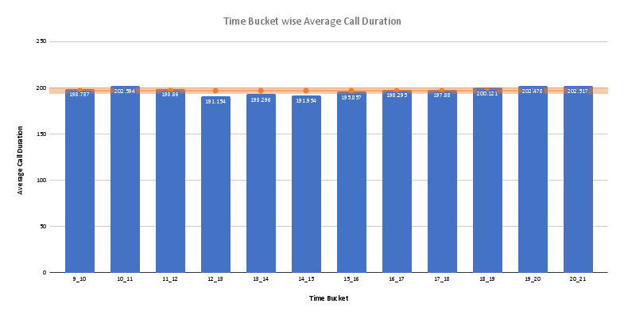
ABC Call Trend Analysis
Average Call Duration: Determine the average duration of all incoming calls received by agents. This should be calculated for each time bucket. Your Task: What is the average duration of calls for each time bucket?
The overall Average Call Duration is 196.963 seconds.
We can observe that the Average Call Duration first peaks in the morning hours before dropping to below average value during the lunch hours and then again increasing to above average value.

Slide 57

ABC Call Trend Analysis
Call Volume Analysis: Visualize the total number of calls received. This should be represented as a graph or chart showing the number of calls against time. Time should be represented in buckets (e.g., 1-2, 2-3, etc.). Your Task: Can you create a chart or graph that shows the number of calls received in each time bucket?
We can observe that the number of received calls received first increases with time before dropping down.
We can also observe that the number of abandoned calls are very high in the morning hours and as the day progresses, the number of abandoned calls reduces.

Slide 58

ABC Call Trend Analysis
Manpower Planning: The current rate of abandoned calls is approximately 30%. Propose a plan for manpower allocation during each time bucket (from 9 am to 9 pm) to reduce the abandon rate to 10%. In other words, you need to calculate the minimum number of agents required in each time bucket to ensure that at least 90 out of 100 calls are answered. Your Task: What is the minimum number of agents required in each time bucket to reduce the abandon rate to 10%?
We can observe that to maintain a maximum of 10% abandon rate, we need to increase the availability of agents in the morning hours by a large margin as in these hours, the number of incoming calls are quite high and the number of agents available currently are quite low.
During afternoon hours and during late evening hours, we need to increase the availability of agents by a slight margin to maintain a maximum of 10% abandon rate.

Slide 59

ABC Call Trend Analysis
Night Shift Manpower Planning: Customers also call ABC Insurance Company at night but don't get an answer because there are no agents available. This creates a poor customer experience. Assume that for every 100 calls that customers make between 9 am and 9 pm, they also make 30 calls at night between 9 pm and 9 am. The distribution of these 30 calls is as follows: Your Task: Propose a manpower plan for each time bucket throughout the day, keeping the maximum abandon rate at 10%.Assumptions: An agent works for 6 days a week; On average, each agent takes 4 unplanned leaves per month; An agent's total working hours are 9 hours, out of which 1.5 hours are spent on lunch and snacks in the office. On average, an agent spends 60% of their total actual working hours (i.e., 60% of 7.5 hours) on calls with customers/users. The total number of days in a month is 30.
From the above heatmap, we can observe that for day of the week, Monday requires the most number of agents in individual time buckets as well as for the overall day as it is starting of the week.
For rest of the days, agent requirement remains more or less the same with Saturday’s and Sunday‘s requirement on the lower side as they are weekends.
For individual time buckets, the most number of agents required is in the morning hours from 9 A.M to 1 P.M and the least number of agents required is at night hours from 12 A.M to 5 P.M.

Slide 60

ABC Call Trend Analysis
Night Shift Manpower Planning: Customers also call ABC Insurance Company at night but don't get an answer because there are no agents available. This creates a poor customer experience. Assume that for every 100 calls that customers make between 9 am and 9 pm, they also make 30 calls at night between 9 pm and 9 am. The distribution of these 30 calls is as follows: Your Task: Propose a manpower plan for each time bucket throughout the day, keeping the maximum abandon rate at 10%.Assumptions: An agent works for 6 days a week; On average, each agent takes 4 unplanned leaves per month; An agent's total working hours are 9 hours, out of which 1.5 hours are spent on lunch and snacks in the office. On average, an agent spends 60% of their total actual working hours (i.e., 60% of 7.5 hours) on calls with customers/users. The total number of days in a month is 30.

Slide 61
ABC Call Trend Analysis
Through this project ,I was able to understand the importance of
Data analysis in the call trend analysis.
Provided the insights regarding the dataset gives the solution to the project and help me to improve my knowledge regarding it.

Slide 62
Summary of Learnings from all projects
Gained technical skills such as Python, Tableau, Matplotlib, Seaborn, SQL and MySQL workbench, NumPy, pandas, Machine Learning, Data Analysis. I have also gained soft skills such as problem-solving, critical thinking, communication.
I have learned how to analyze data and extract useful insights to provide recommendations for price optimization & product development decisions to maximize profitability, manpower planning to reduce call abandon rate from 30% to 10% and improve customer experience, understand how customer attributes & loan attributes influence the likelihood of default and make decisions such as denying the loan, reducing loan amount etc., Find business insights that can be used by teams across the business to launch a new marketing campaign, decide on features to build for the app and measuring user engagement and improving the experience altogether while helping the business grow.
I have also learned how to use Advanced SQL skills to analyze the data to answer questions posed by different departments within the company and provided valuable insights that can help in improving the company’s operations and understand sudden changes in key metrics. I have generated meaningful insights from the IMDB dataset to plan every move analytically based on data and helped the company to make movie that appeals to both Indian and global audience while minimizing the risk of losses.
Finally, you have analyzed previous hiring dataset of an MNC to observe trends and drawing insights out of it useful for hiring department and helped the company to improve its hiring process.

Slide 63

Home
Photo
About Us
Contact
THANK YOU
devadhivyavv11@gmail.com
LinkedIn : www.linkedin.com/in/ divyasri-jegan-407a3223b

